Slide 1
Data Science Bootcamp
Spring ’25

Slide 2



Data Analyst
Data Analyst vs Data Engineer vs Data Scientist
Data Engineer
Data Scientist
A data analyst is responsible for collecting, organizing, and analyzing data to identify patterns and insights that can be used to make data-driven decisions.
Skills: Python, SQL, Data Visualization
A data engineer is responsible for designing and implementing the infrastructure and tools needed to collect, store, and process large amounts of data.
Skills: Python, ETL & Data Modeling, Big Data Technologies, SQL , Data Storage, Data Pipeline Tools.
A data scientist is responsible for collecting, analyzing, and interpreting complex data sets using statistical and ML techniques. A data scientist works with a wide variety of data and is responsible for finding patterns and insights that can be used to drive business decisions.
Skills: Python, Machine Learning Data Visualization, Big Datam SQL

Slide 3
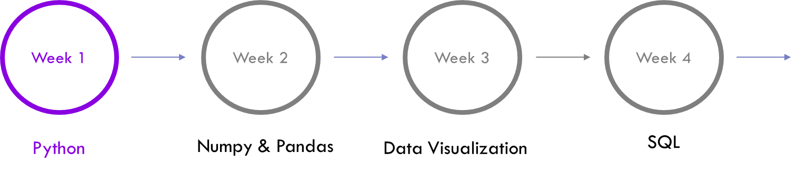
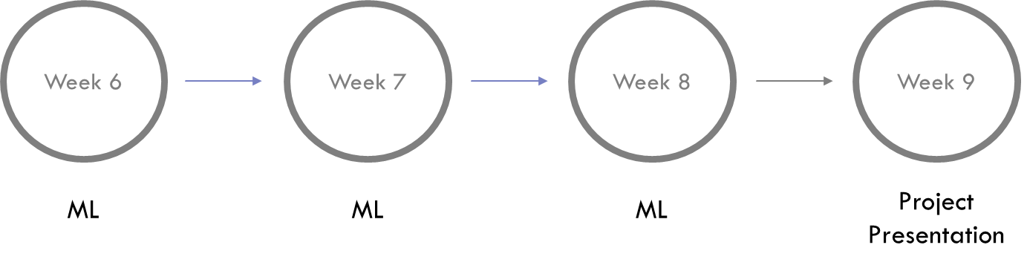

Bootcamp Timeline

Slide 4

Logistics
Join the SLACK community – Perfect place to ask your questions and discuss interesting problems and find project teammates.
Visit the GitHub page to access PPTs and Colab notebooks discussed in each section.
You can email us at datasciencebootcamp@nyu.edu

Slide 5

Agenda
Why Python ?
Datatypes
Control Statements
Loops
Functions
Scope

Slide 6


Why use Python?
EASY to read, learn and write. It is a High Level language.
Its HIGHLY PRODUCTIVE – Much more concise and requires less time, effort and lines of code to perform the same operations.
It is slow but Development Speed >> Execution Speed
Big Community – Rich set of standard libraries and frameworks for several purposes.
Fun Fact : Python is written in C

Slide 7
Q&A

